Slide 1


Team 48: Pocket Diagnostics
Bi-Weekly Update 5 Team members: Rohan Bharadwaj, Donavan Burrow, Jacob Newlin, Elijah Rodriguez Sponsor: Dr. John Lusher
TA: Zian Wang
Notes:
Michelle

Slide 2
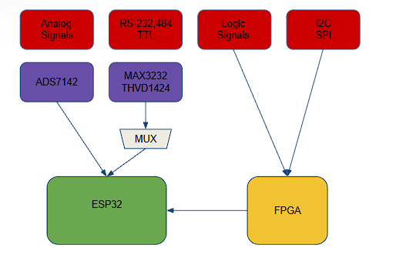
Project Summary
Problem statement:
Technicians in the electronics industry have evolved to servicing customers directly for consumer products, similarly to a plumber or electrician. Often they cannot bring or access bench devices and a suitable substitute is required to complete a job in a timely manner.
Function of the Pocket Diagnostics:
Provide a simple, man portable bench device that can evaluate low frequency electrical signals, I2C data signals, SPI data signals, Serial data signals and 16 channel logic signals for troubleshooting on devices that contain such data transfer methods.

Slide 3
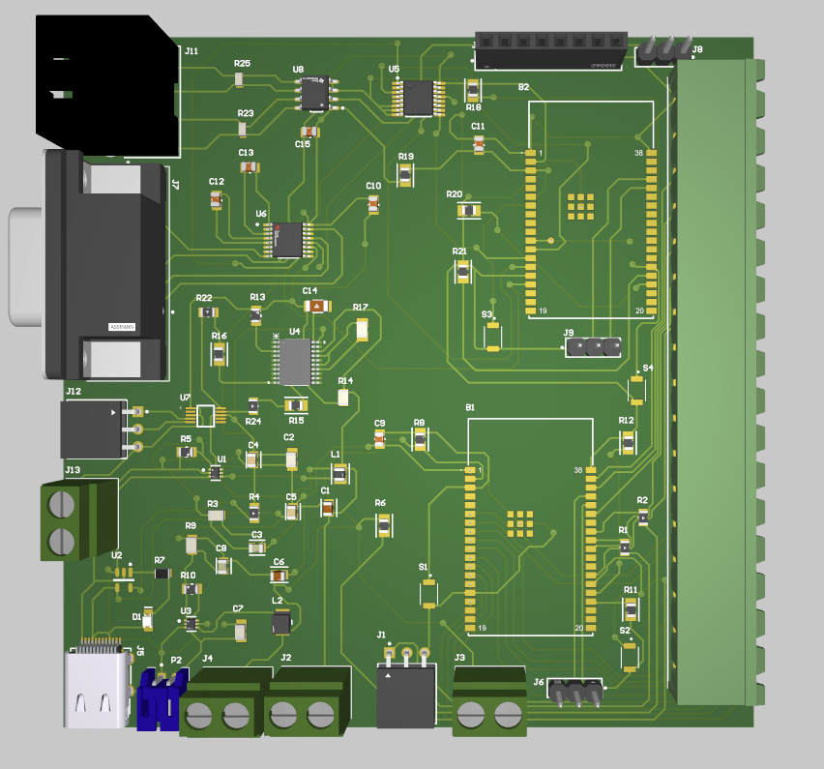
Integrated System Diagram
Notes:
Eric

Slide 4
Project Timeline
Subsystem Designs and Testing (to complete by 2/17 ) | Integration of Power and Data Processing subsystem with Data Acquisition and Communication Subsystem (to complete by 3/21) | Integration of App Development subsystem with Firmware subsystem. (to complete by 3/3) | Final Integration (to complete by 3/21) | System Test (to complete by 3/27) | Validation (to complete by 3/31) | Demo and Report (Prepared by 4/3)
Notes:
Eric

Slide 5
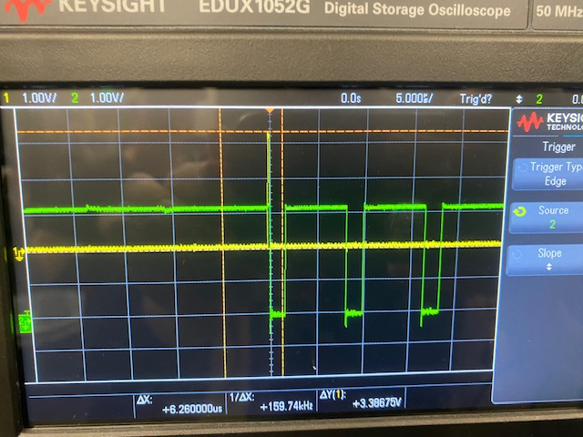
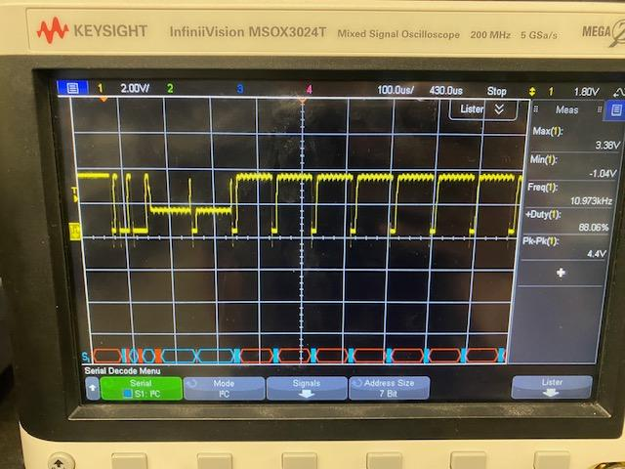
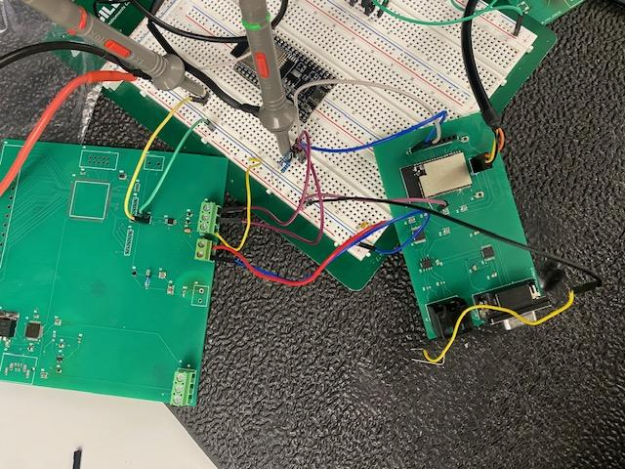
Firmware
Accomplishments since last update 35-40 hrs of effort | Ongoing progress/problems and plans until the next presentation
-Validated RS232, Oscilloscope -Determined FPGA will not work and moving to two ESP32s -Fully integrated and begun stress testing of BLE communication with app | -Started work on I2C,SPI and 16 channel code - Adding new tasks to ESP32-1 for SPI and uart configs

Slide 6
Data Processing and Power
Accomplishments since last update 30-35 hrs of effort | Ongoing progress/problems and plans until the next presentation
- Tested ADC Converter - ADC converter is able to receive external analog input signals and communicate with the ESP32 and mobile application. - PCB is able to receive power from the battery. - ADC converter receives the appropriate input voltage values. - Updated integrated PCB schematic to replace FPGA functionality with additional ESP32. | - Assemble integrated board - Test and validate integrated board

Slide 7
Data Collection and Communication
Accomplishments since last update 30 hrs of effort | Ongoing progress/problems and plans until the next presentation
- Tested Serial Port Sniffer with Jacob and Donovan - Began Integrated PCB with Rohan - Updated integrated schematic and PCB for TTL protocol and RS232 issue | - Order (if not done so already) and assemble integrated board - Test and validate integrated board

Slide 8
Phone Application
Accomplishments since last update 20 hrs of effort | Ongoing progress/problems and plans until the next presentation
-Validated RS232, Oscilloscope -Begun stress testing of BLE communication with Firmware/Hardware -Fixed bugs with UI glitching on Oscilloscope | -System Battery Indicator incorporation -Continue Validation for 16 Channel Logic Analyzer, RS485, and TTL

Slide 9
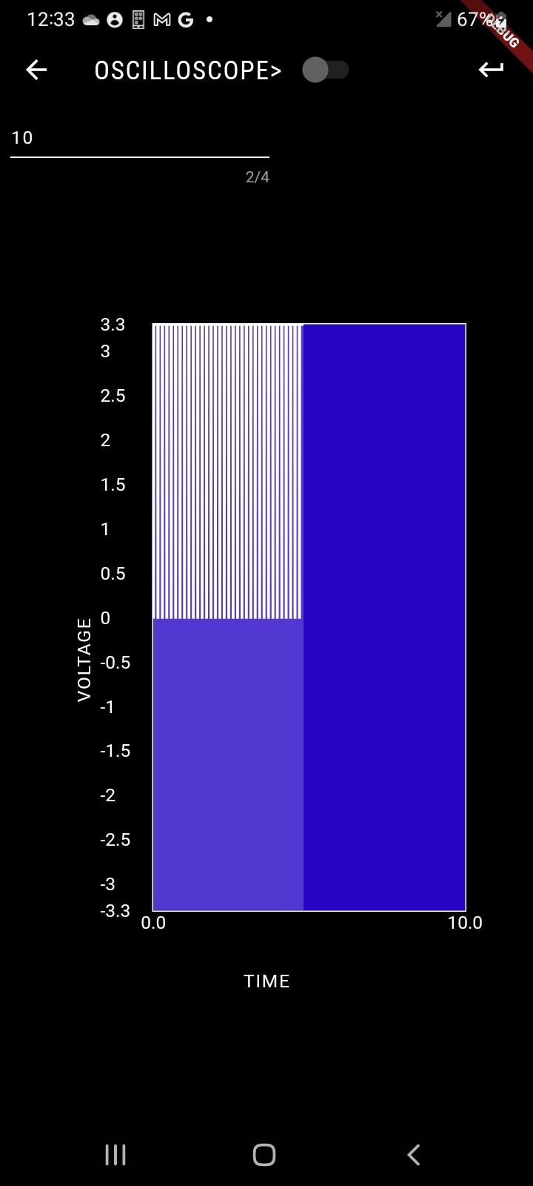
Phone Application cont.

Slide 10
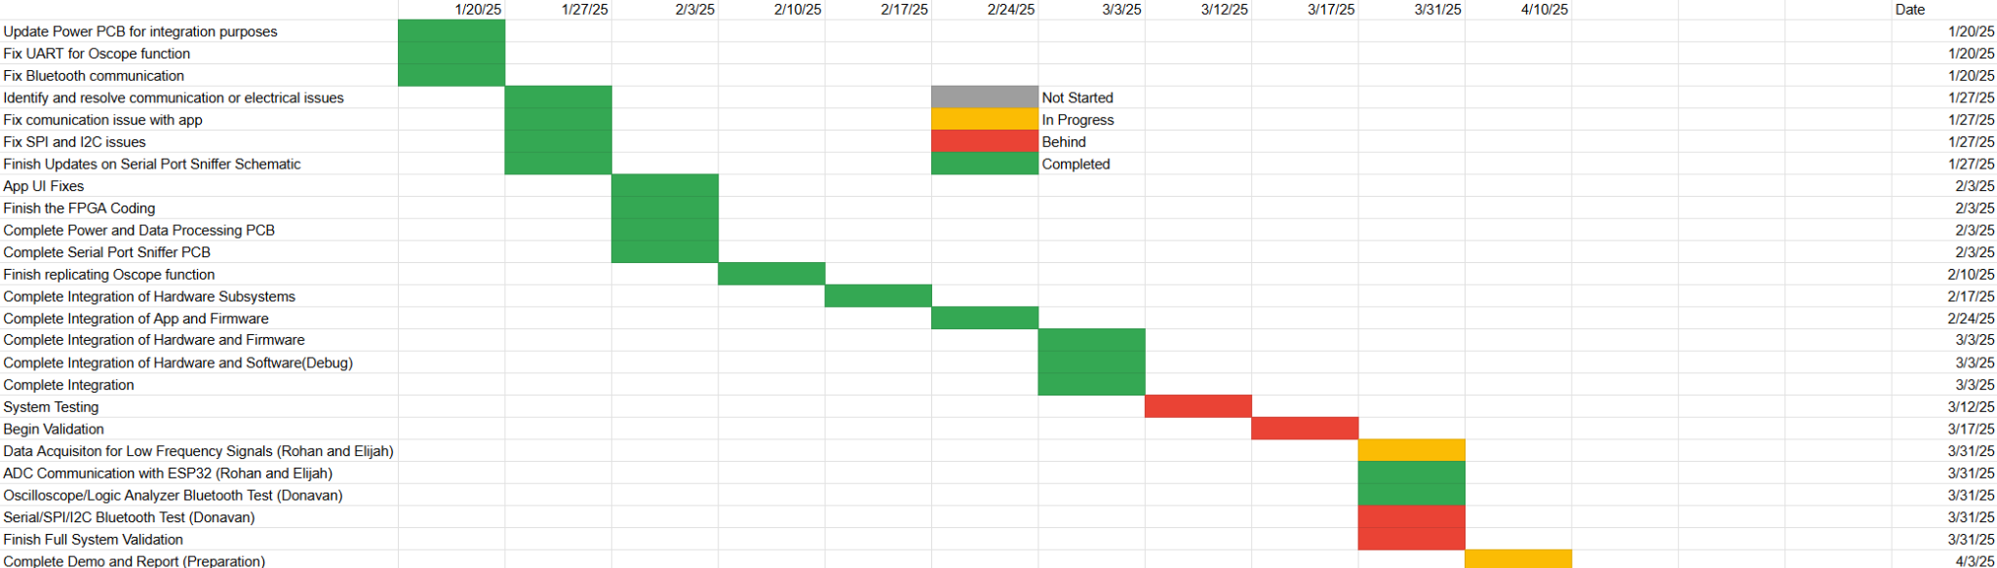
Execution Plan
Notes:
Michelle

Slide 11
Validation Plan
Paragraph # | Test Name | Success Criteria | Data | Status | Pass/Fail | Responsible Party
3.2.1.1 | Multi-Protocol Communication | Perform multi-protocol I. communication.1 MHz clock rate |  | UNTESTED |  | Rohan Bharadwaj, Elijah Rodriguez
3.2.1.2 | Data Acquisition for Low-Frequency Signals | Support data acquisition for low-frequency signals (up to 100 kHz) |  | TESTED | Pass | Rohan Bharadwaj, Elijah Rodriguez
3.2.1.3 | Logic Analysis | Capture and analyze signals with a sampling rate of up to 50 MS/s |  | UNTESTED |  | Rohan Bharadwaj
3.2.2.4 | Battery Life | 2 hours |  | UNTESTED |  | Rohan Bharadwaj
3.2.3.1.1 | Power Consumption | Maximum peak power should not exceed 4.5W |  | UNTESTED |  | Rohan Bharadwaj
3.2.3.1.2 | Input Voltage Level | 3.0-4.2V |  | TESTED | PASSED | Rohan Bharadwaj
4.3.1.1 | Power Distribution Validation | MAX3232 and THVD1451 receive 3.3V from ESP32 |  | TESTED | PASSED | Elijah Rodriguez
4.3.2.1 | MAX3232 and THVD1451 Level Shifting Verification | Voltage levels to 3.3V for the MAX3232 and THVD1451 |  | TESTED | PASSED | Elijah Rodriguez
4.3.3.1 | RealTerm Communication Validation | Ensure transmitted and received data match the RealTerm program |  | TESTED | RS485 PASSED | Elijah Rodriguez
4.3.4.1 | Signal Integrity Validation | Stable signal waveforms for RS protocols |  | TESTED | RS485 PASSED | Elijah Rodriguez

Slide 12
Validation Plan
Paragraph # | Test Name | Success Criteria | Data | Status | Pass/Fail | Responsible Party
5.2.1 | Bluetooth Connection Event | Connection event displayed on app for phone and ESP32 | “Device Connected” displayed in terminal | TESTED | PASS | Donavan Burrow, Jacob Newlin
5.2.2 | Bluetooth Read | “Received Data” List with all data displayed | ‘Received Data: […]’ | TESTED | PASS | Donavan Burrow, Jacob Newlin
5.2.2 | Bluetooth Write | Terminal Displays all data transactions | ‘utf8(“Data type”), Time, Time’ | TESTED | PASS | Donavan Burrow, Jacob Newlin
5.2.3 | Data Display | Phone displays correct data on graph for each data type | Logic Analyzer, RS-485 and TTL Incomplete | TESTED | FAIL | Donavan Burrow

Slide 13
Thank You!

